Slide 1
SQL
Views , Joins , Stored Procedures & Triggers

Slide 2
SQL Views
A VIEW is actually a query and the output of the query becomes the content of the view.
A VIEW is a data object which does not contain any data. It's contents are the resultant of a base table. They are operated just like base table but they doesn’t contain any data of their own.

Slide 3
How to create and use “View”
CREATE VIEW view_name AS SELECT column_list FROM table_name [WHERE condition];
CREATE VIEW view_Employee AS SELECT emp_id, emp_name FROM Employee;
Select * from view_Employee where location=‘London’;

Slide 4
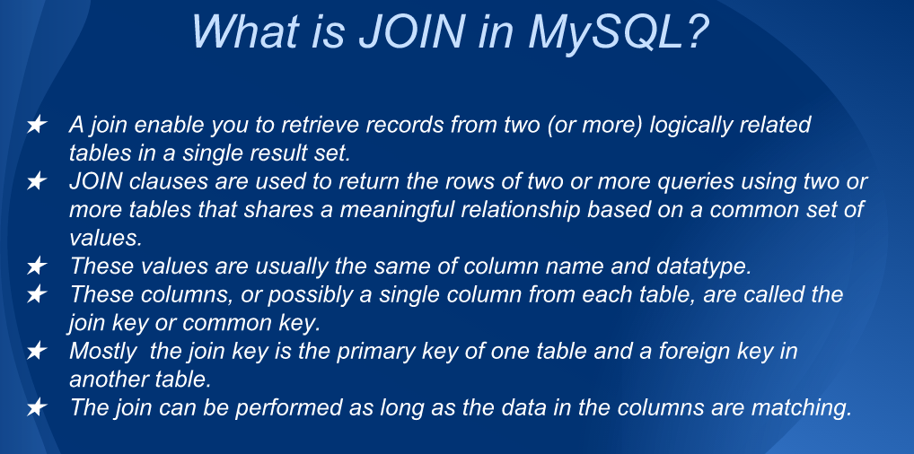

Slide 5
Need of Joins
Student Id | Student Name | Education Domain
101 | Mike | Software Development
102 | Jenny | Software Testing
103 | Ketty | Project Design & Doc.
104 | Enrique | Database
Course Id | Course Name | Duration
7789 | Java | 13 Days
7788 | HP Test Runner | 5 Days
7765 | Viso Doc and UML Editing | 3 Days
Student ID | Course Id | Course Schedual
101 | 7765 | May
102 | 7765 | May
103 | 7789 | December
101 | 7788 | June
104 | 7788 | June

Slide 6


Select * from Table_One Join_Type Table_Two ON
Condition
Syntax

Slide 7
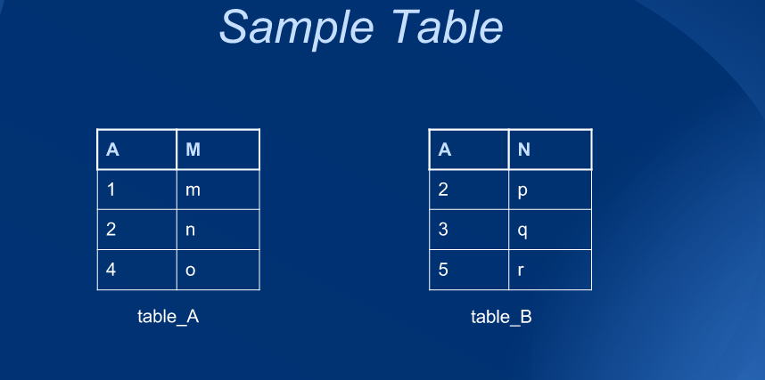

Slide 8
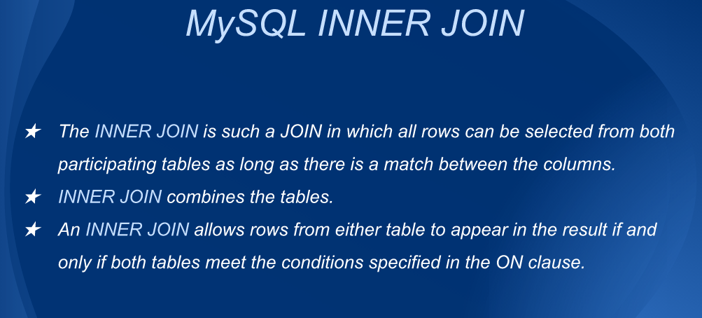

Slide 9
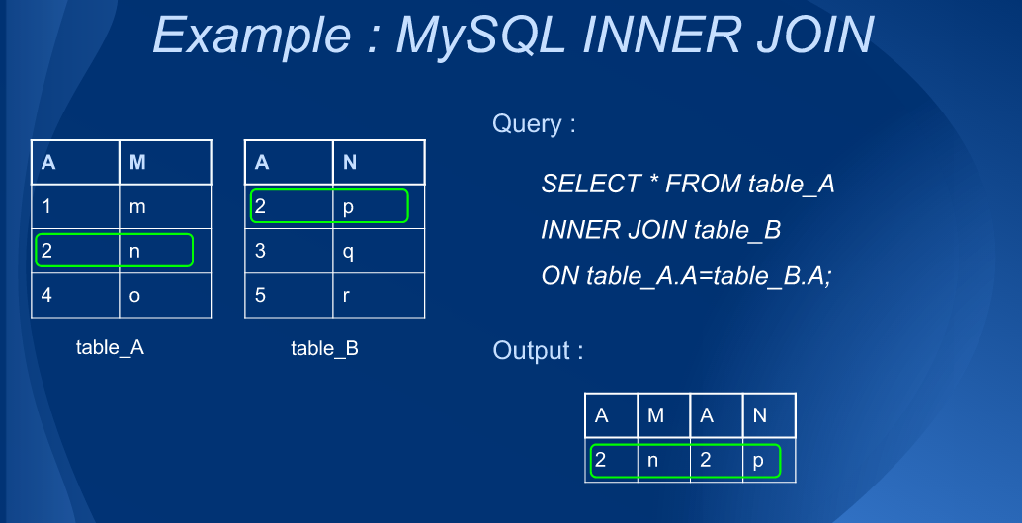

Slide 10
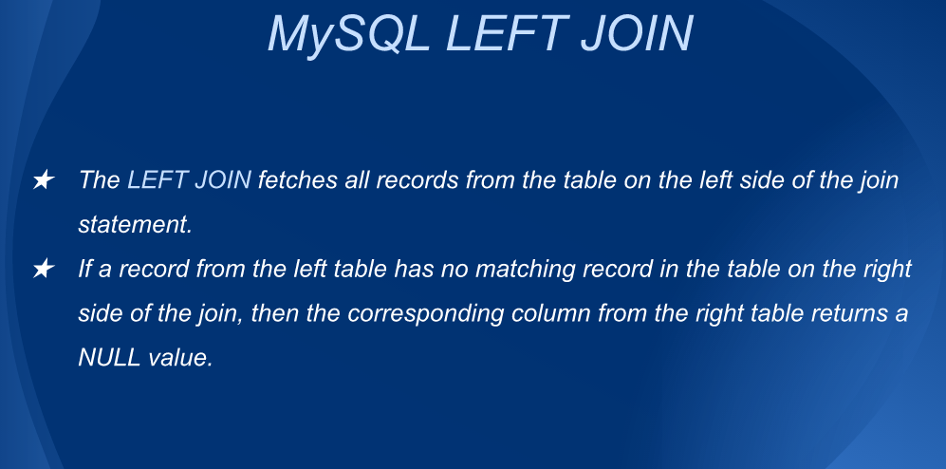

Slide 11
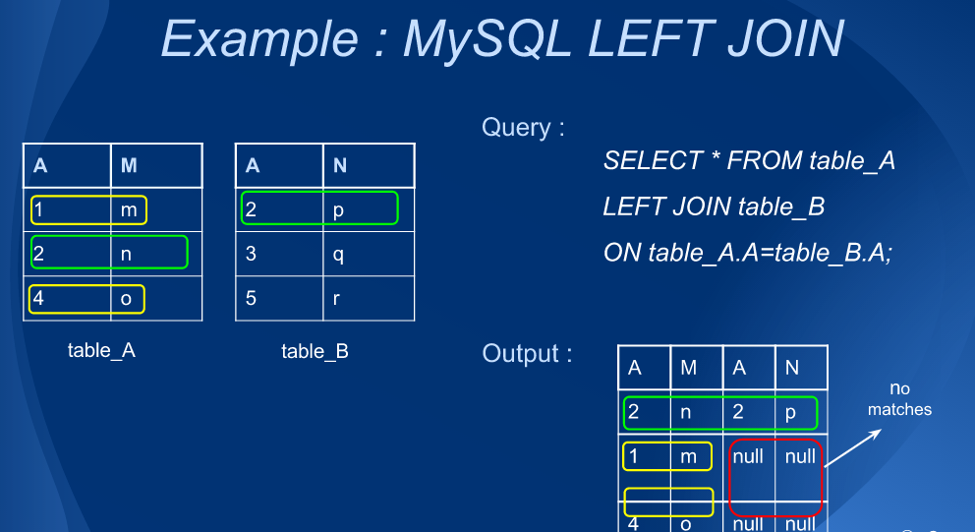
0..0

Slide 12
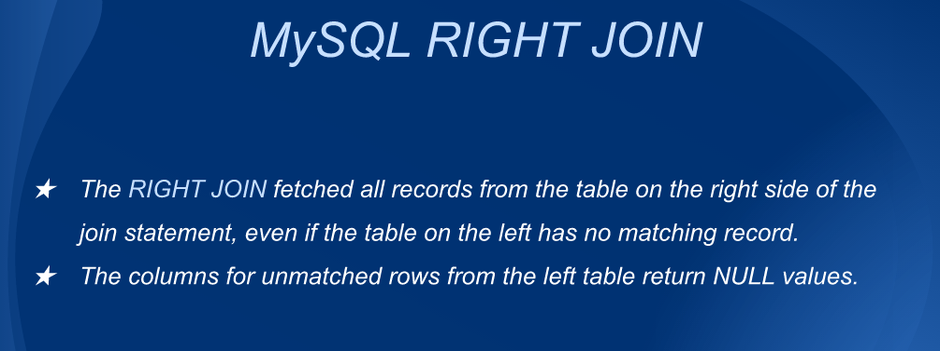

Slide 13
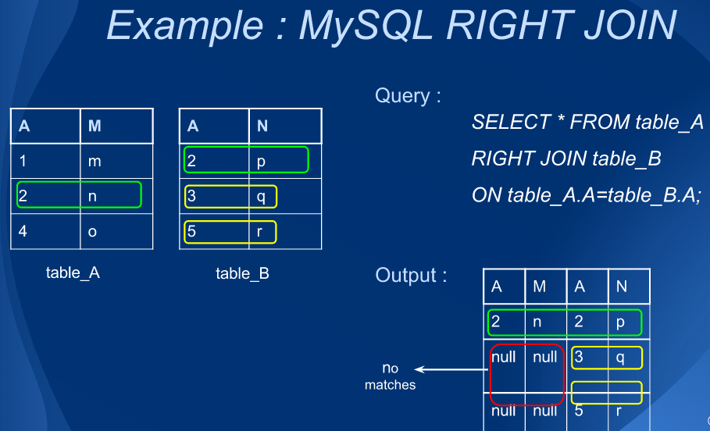

Slide 14
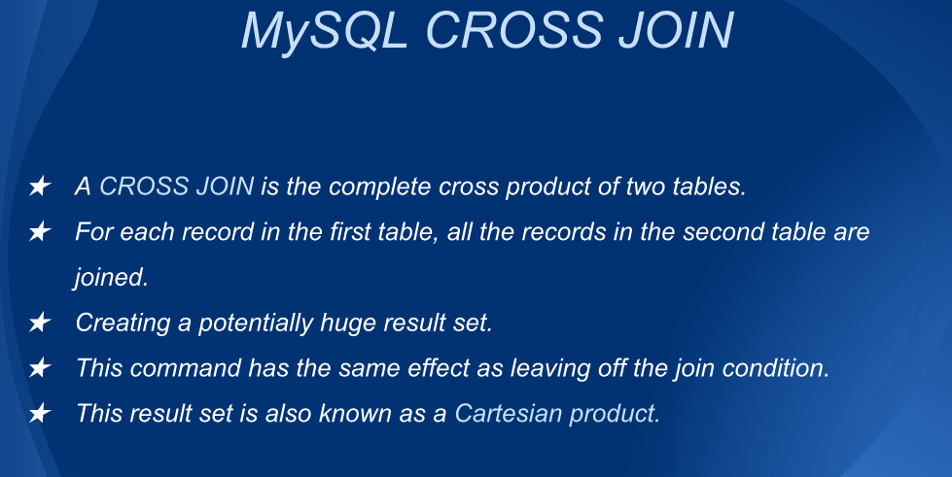

Slide 15
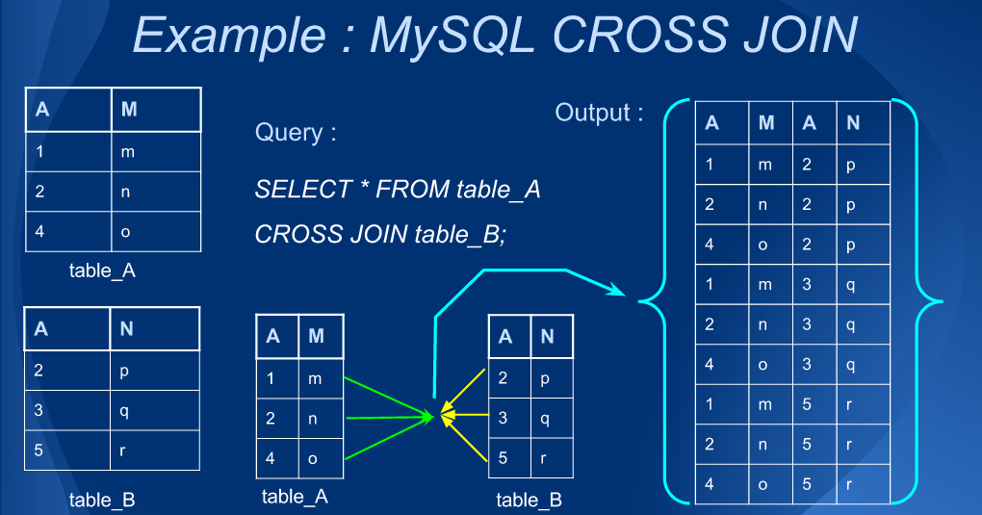

Slide 16
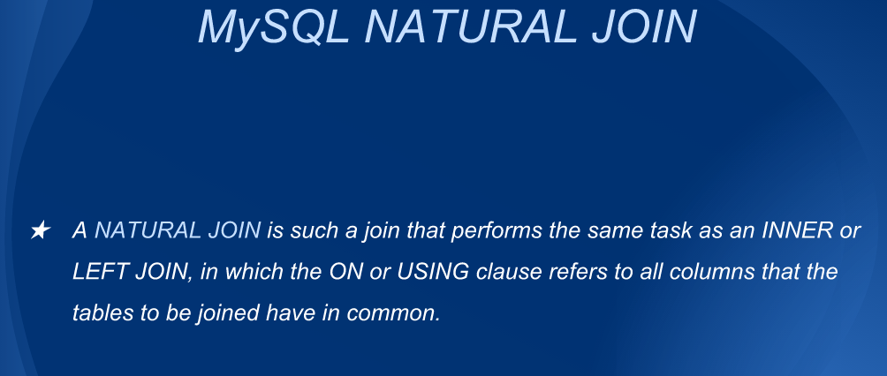

Slide 17
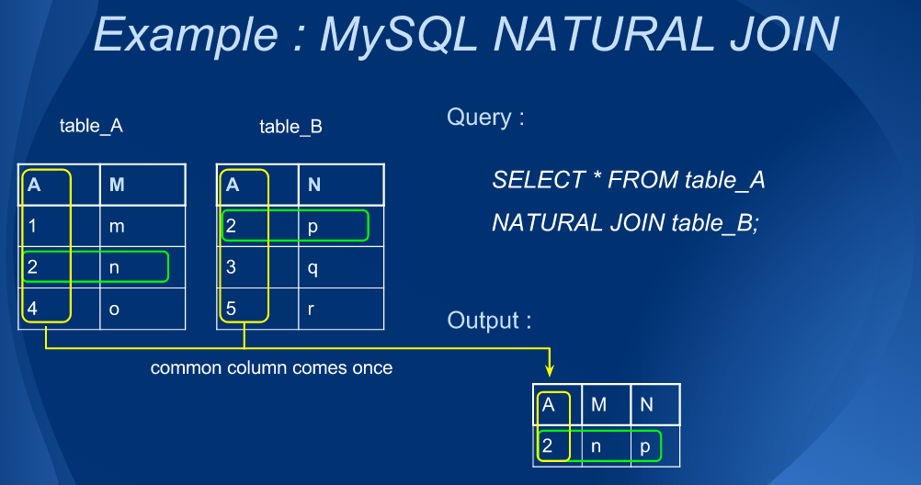

Slide 18
Stored Procedures
A stored procedure is nothing more than prepared SQL code that you save so you can reuse the code over and over again.
In addition to running the same SQL code over and over again you also have the ability to pass parameters to the stored procedure.

Slide 19
Creating MYSQL Stored Procedure
mysql> DELIMITER //
mysql> CREATE PROCEDURE getStudentName()
mysql> BEGIN
mysql> SELECT * FROM Student;
mysql> END//
mysql>
mysql> DELIMITER ;

Slide 20
Passing Parameters to Stored Procedures
The Parameters make the stored procedure more flexible and useful.
In MySQL parameter has three modes IN,OUT, or INOUT.
IN (Default Mode) when u define an IN parameter it means the calling program has to pass the arguments.
The value of an IN parameter is protected.

Slide 21
Continue….
OUT – The value of an out parameter can be changed inside the procedure and its new value is passed back to the calling program. (Note : the S/P cannot access the initial value of the OUT parameter when its starts)
INOUT : An INOUT parameter is the combination of IN parameter and OUT parameter. It means that the calling program may pass the argument, and the stored procedure can modify the INOUT parameter and pass the new value back to the calling program.
Syntax getEmployeesByDept( MODE param_name param-type(param size))

Slide 22
Example
DELIMITER //
CREATE PROCEDURE GetEmployeeByDept(IN dptName VARCHAR(255))
BEGIN
SELECT *
FROM Employee
WHERE department = dptName;
END //
DELIMITER ;
CALL GetEmployeeByDept(‘Marketing’);

Slide 23
MySQL Triggers
A trigger is a set of actions that are run automatically when a specified change operation (SQL INSERT, UPDATE, or DELETE statement) is performed on a specified table.
A SQL triggers are special type of stored procedures

Slide 24
Where to use Triggers
Enforce business rules
Validate user Input
Generate Unique Value.
Access system functions.
Replicate data to different file.
Perform some auditing task.

Slide 25
Creating Trigger
CREATE TRIGGER [trigger_name] [trigger_time] [trigger_event]
ON table_name
FOR EACH ROW
BEGIN
……
END
INSERT, UPDATE or DELETE
Before Or
After

Slide 26
Example
CREATE TRIGGER update_audit BEFORE UPDATE
ON SALES
FOR EACH ROW
BEGIN
CALL updateAuditProcedure();
END

Slide 27
END

